Slide 1

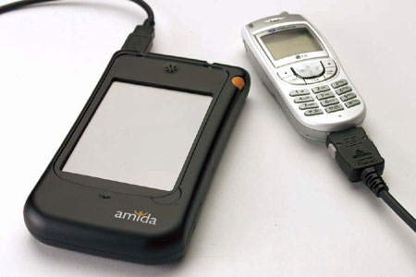
Bajaj Institute of Technology, Wardha
SIMPUTER
Shantanu P. Potdar
Introduction
Architecture
Conclusion/Future Scope
A Simputer is a multilingual, mass access, low cost, portable alternative to PC's by which the benefits of IT can reach the common man.
First released on 21 April 2001.
Dr. Swami Manohar was leader (Group of seven scientist)
It uses Microsoft's Windows XP operating system.
HARDWARE
CPU 32 bit.
64MB of DRAM.
24MB flash for permanent storage.
Display I/F 32 x 240 monochrome LCD display panel
INTERFACES
Touch panel overlay on LCD Display used with a plastic stylus (pen).
Speaker, Microphone, MIC jacks, Smart card connector.
RJ-II telephone jack .
USB connector.
DIMENSIONS
Approximately 8cm x 13cm x 2cm .
Power supply 3AAA sized batteries.
Simputer holds promise for bringing low cost computing to poor countries.
Given the high illiteracy rates in developing countries, the devices uses image and sound as primary outputs and touch as its primary input.
It employs Unicode and so it support multilingual text along with text to speech capabilities.
Manufacture
Licensed by the Simputer Trust
Open to suggestions
Wireless Simputer
IEEE 802,11B / Bluetooth
GSM / CDMA
Objectives
Even the poorest of the poor will pay for the service ,if that service improves in some way their quality of life.
Several corporates are now addressing rural markets and they have the need for information and communication infrastructure in remote location.
References
https://en.wikipedia.org/wiki/Simputer
https://cupdf.com/document/simputer-document.html
https://www.pcmag.com/encyclopedia/term/simputer
http://www.123seminarsonly.com/Seminar-Reports/005/Simputer.html
Department of Computer Engineering
Third Semester/Roll No.:242

